Slide 1
Happiness

Slide 2
The Meaning and Measure of Happiness
How should we evaluate the well-being of a society, a community, an individual life? What measurable qualities should we use?
I. Traditional Measures of Well-Being
Economic Indicators - income, unemployment, inflation,
poverty, inequality, home ownership, job growth, etc.
Mental Health - depression, stress, suicide, autism, etc.
Physical Health - cancer, heart disease, obesity, etc.
Quality of Life - best cities, services, jobs, environment.
II. Positive Psychology - Critique
1. What is not measured .
2. Misleading assumptions.
3. Limits of objective measures & importance of subjective judgments.

Slide 3
Limitations of Traditional Measures
1. Assess negatives not positives of life -
Misery index - do not directly measure health & happiness.
Problem: Surveys shows happiness & life satisfaction important life goal.
Cory Keyes: positive health vs. only illness rates.
2. Infer health & happiness -
Assumes: well-being/happiness = absence of misery or negative functioning - if not unhappy or ill must be ok - doing better when misery index goes down.
Problem: absence of misery (e.g.depression) not same as
health and happiness.
3. Objective measures not same as subjective experience -
Assumes: money/material possessions primary factor in “good life.”
Happier - when income, jobs go up, etc.
Problem- faulty assumption - objective life circumstances, money, income very weakly related to happiness - threshold effect.

Slide 4
Positive Psychology’s Alternative Measures
1. Measure happiness directly, not indirectly -
No inferences - are we happy or not?
2. Define and measure aspects of positive functioning directly.
What is a good life beyond absence of misery?
What is on the other side of zero? Millions “languishing” but not mentally?
How many show positive mental health, optimal functioning, flourishing?
3. Give primacy to subjective nature of health & happiness.
People’s interpretation of their life matters as much as facts.
Make a Difference?
National Subjective Well-Being Index – Ed Diener.
Complement economic and social indicators.
Quality of life that includes subjective factors
Sense of community, happiness, beauty, promotion of positive behaviors.
Two examples:
In Germany..they use German Socioeconomic Panel
In Europe: Eurobarometer

Slide 5
What Is Happiness & Well-Being?
Two Traditions (Views) of Happiness and Well-Being
1. Hedonic View – Happiness & Satisfaction (SWB)
- Happiness is person’s own subjective judgment of the overall balance of “good” and “bad” in their life.
From own point of view how satisfied are you, are positive emotions and events running ahead of negative?
Satisfaction + abundance of positive emotions (happiness).
2. Eudaimonic View – Self-Realization & Optimal Functioning
- Happiness and well-being more than emotion and satisfaction.
- Happiness – More to life than subjective pleasure.
Deeper meanings + mental/emotional health.
A. Self-realization & meaning: Eudaimonic – daimon = true self
Happiness and well-being result from expressing our inner potentials, self-realization of talents and values, and healthy positive functioning. Satisfaction from overcoming challenge. Deserve our happiness and satisfaction because of abilities and effort.
B. Optimal functioning - Can you be happy and mentally ill, i.e., not healthy?
Eudaimonic view things should be able to tell the difference.
Health involves doing the hard things - not necessarily happy.
Eudaimonic view – Definition/measure of well-being should define basis of happiness and health.

Slide 6
Comparison: Overlapping but Different
Waterman: If you wanted another person to know about who you are and what you are like as a person, what five activities of importance to you would you describe? List four activities. 1,2,3,4. Rate each activity twice (using 3 PE and HE criteria)
7 6 5 4 3 2 1
Strongly Agree Slightly uncertain Slightly Disagree Strongly
Agree Agree Disagree Disagree
PE (Personal Expressive- Eudaimonic enjoyment)
1. This activity gives me my strongest feeling of really being alive and expressing my best potentials.
2. When I engage in this activity I feel this is what I was meant to do.
3. When I engage in this activity I feel more intensely involved than I do in most activities, a feeling of special fit or meshing, high concentration, challenge, and effort.
HE (Hedonic Enjoyment)
1.This activity gives me the strongest sense of enjoyment and pleasure. I’m relaxed and content.
2. When I engage in this activity I forget about my problems and lose track of time. Easy to do…go with the flow.
3. When I engage in this activity I feel happier and more excited than I do in other activities.
Found: PE & HE r =.70 to .80 50 to 66% overlap.

Slide 7
Laura King - Positive Affect and Meaning
Traditional opposition of pleasure and meaning - shallow vs. deeper
King: How positive affect/emotion may contribute to meaning
Positive emotions enhance meaning - fun with friends, scenery - think of larger context, appreciation of life, what’s important
Positive emotions as markers of meaningful events
Personally expressive/meaningful events also pleasant
e.g., Christmas - childhood memories
Six studies:
Diary study: Each day – found something purposeful & meaningful -reason for being here
rated positive affect
Expt. Manipulate mood
All showed meaning and positive emotions strongly related
Two-way street - each contributing to other

Slide 8
Differences & Similarities
Differences
Hedonic View: Happiness = Positive Emotions + Satisfaction
Basis of happiness to be discovered through research - empirically.
Why we are happy not answered by theory or definition.
Quick and easy measures - easy to assess.
Research-driven approach.
Eudaimonic View = Personal Expressiveness, Optimal Functioning, Positive Mental Health, and Meanfulness
Definition specifies basis for well-being, i.e., why/what makes us healthy. Likely to also make us happy but maybe not in the short-term..e.g., strength to end bad relation, confront conflicts, say “no.”
Complicated, lengthy & involved assessment.
Theory-driven…define well-being in way that includes why.
I.e., criteria for healthy, fully functioning person.
Simiarities
Moderate to strong correlations of r =.6. Tapping similar dimensions.

Slide 9
Hedonic View: Subjective Well-being (SWB)
Subjective Well-Being – (self-reported)
(dominates research)
Colloquially - happiness.
Relatively stable and pervasive sense that life is “good.”
Initially conceived as three major components:
1. Life satisfaction - global judgment about one’s life
2. Positive affect - experiencing many positive emotions and moods
3. Negative affect - experiencing low levels of negative affect (low negative emotion & mood) (independence of pos. & neg.)

Slide 10
Global Measures
Life Satisfaction - single and multiple item scales
- “Taking all things together, how would you say things are these days? Would you say you are very happy, pretty happy, or not too happy?”
- “How satisfied are you with your life as a whole these days?
Very satisfied. Satisfied. Not very satisfied. Not at all satisfied?”
Rate on 7-point scale from delighted to terrible:
- “Which face comes closest to expressing how you feel about your life as a whole?” Choose face: smile through neutral to frown
Lyubormirsky - Subjective Happiness Scale
Life Satisfaction Scale - Ed Diener
7 Strongly agree
6 Agree
5 Slightly agree
4 Neither agree nor disagree
3 Slightly disagree
2 Disagree
Strongly disagree
_____1. In most ways my life is close to my ideal.
_____2. The conditions of my life are excellent.
_____3. I am satisfied with my life.
_____4. So far I have gotten the important things in life.
_____5. If I could live my life over, I would change almost nothing.
Add item ratings divide by 5 - Satisfaction ranges from 1 to 7

Slide 11
Satisfaction in Life Domains
Life satisfaction as total of satisfaction in important areas of life.
More informative than global measure.
How satisfied are you with:
Work
Finances
Friends
Marriage
Direction country is going
Sports
Hobbies, etc….
Emotional Component of SWB
General Emotional State
During the past few weeks have you ever felt:
Particularly excited or interested in something?
Proud of an accomplishment?
On top of the world?
That things are going your way?
Calm & peaceful?
Extremely happy?
During the past few weeks have you ever felt:
So restless you couldn’t sit long in a chair?
Very lonely or remote from people? Bored?
Depressed or unhappy?
Upset because someone criticized you? Hopeless? Worthless?
Specific Emotions
PANAS

Slide 12
Scoring & Interpretation
- Specify a time period - last week, this month, today.
- Compute separate scores for positive and negative emotions.
Positive affect & negative affect largely independent for given time period versus at one point in time.
-Subtract negative from positive or divide positive by negative.
-Happiness defined as lots of positive and few negative emotions.
Finding: Happiness best predicted by frequency, not intensity, of positive emotions. Intense moments of joy/ecstasy rare.
Summary: SWB = happiness - 3 parts (combined/separated in research)
Life Satisfaction
Positive Affect
Negative Affect

Slide 13
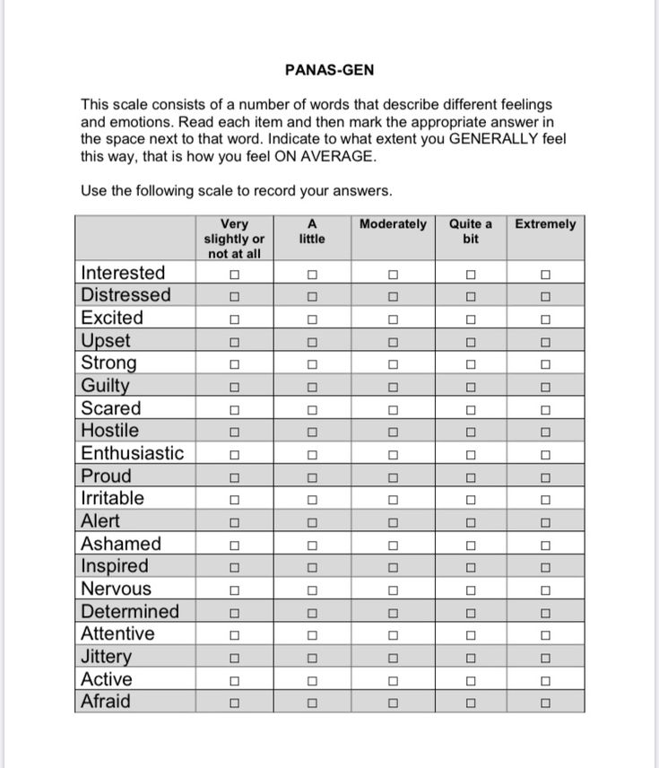
Positive affectivity and Negative affectivity Schedule (PANAS) (Waston, Clark, & Tellegenm 1988)

Slide 14
Validity & Reliability of SWB Measures
1. Reliability:
-Most measures show moderate to strong inter-correlations.
ESM moderate correlations with global measures.
-Multi-item scales of life satisfaction and positive and negative emotions typically exceed r = .80; single item scales less.
Moderate stability & consistency over time - i.e., reliable.
Sensitive to changes in life circumstances but also stable over long periods.
As good or better than other measures in psychology.
2. Validity:
Measures of SWB correlate with other traits & behaviors.
Happy people act happy.
-Confirmed by reports of friends, family, & co-workers.
- Outgoing, smile, laugh, work satisfaction, mental health.
Longevity, etc…..
Global Self-Report Measures versus Experience Sampling
Global self-report measures susceptible to several sources of distortion. Asking to integrate experiences over long time periods.
1. Current mood - Schwartz & Strack
Finding money, my team wins, dirty & hot & smelly, sunny day.
2. Memory - selectivity & weighting
a. Peak-end-rule - Kahneman - peak intensity & ending intensity given most weight in emotional experiences - not duration.
How bad/good and how it ends...not how long it lasts.
Ice water, aversive sounds.
b. State-dependent memory: mood = recall cue
happy - remember good things
unhappy - remember all bad

Slide 15
Experience Sampling Methods
1. Experience Sampling methods (ESM)
The potential for biases in self-report measures has led some researchers
to argue that moment-to-moment measures of experience are both
more accurate and more revealing of the factors and process that
underlie SWB.
Experience sampling methods encompass a variety of measures that provide a “day-in-the-life” view of emotions and events in people’s lives.
Measures of what people are doing and how they are feeling may be taken in real time as they occur, or they may be taken retrospectively, shortly after events occur within the sampled time frame (keeping a daily diary)
Beeper studies (hand computer, etc.) – report mood & what.
Doing random times throughout day over period of weeks or months.
Sample emotional experiences “on-line” as they happen.
Less chance for memory errors & emotional distortions.
40% of daily fluctuations related to days of week.
Good mood on Friday & weekends…Monday = bummer.

Slide 16
The Day Reconstruction method (DRM)
2. Retrospective measures (easier, less disruptive)
Day Reconstruction Method – Kahneman
- Diary – record feelings and day’s events over time.
The DRM also reduces the burdens of disruption and time commitment imposed on research participants with the Experience Sampling Method (ESM) approach.
Global measures versus ESM
Global - maximal sensitive to traits & meaning.
ESM - max sensitive to states & short-term reactions.
Self-Realization: The Eudaimonic Basis of Well-Being
The three-component view of Subjective well-being (SWB) has been expanded by some psychologists to include personal qualities, and life activities believed to be the psychological underpinning of happiness.
Psychological well-being and positive functioning
Emotional well-being
Psychological well-being
Social Well-being
Need Fulfillment and Self-Determination theory

Slide 17
Self-Realization: The Eudaimonic Basis of Well-Being
Psychological well-being and positive functioning
Carol Ryff (1989) argued that the three-component model of SWB fails to describe the features of a person’s life that provide the basis and meaning of well-being.
Well-being is more than happiness with life.
Well-being should be source of resilience and in the face of adversity and should reflect positive functioning, personal strengths, and mental health.
Well-being and happiness are based on human strengths, personal striving, and growth.
Eudaimonic Well-being involves the two broad dimensions of emotional well-being and positive functioning
1. Emotional well-being: Positive Feelings
2. Psychological well-being: Positive Functioning
3. Social well-being: Positive Social Functioning

Slide 18
Complete Mental Health
I. Emotional Well-Being
1. Positive Affect - experience of positive emotions like joy & happiness.
During the last 30 days, how much of the time did you feel cheerful, in good spirits, extremely happy, calm and peaceful, satisfied and full of life?
2. Negative Affect - absence of emotions suggesting life is unpleasant.
During the last 30 days, how much of the time did you feel so sad nothing could cheer you up, nervous, restless or fidgety, hopeless, that everything was an effort, worthless?
3. Life Satisfaction – sense of contentment and satisfaction with life.
During the last 30 days, how much of the time did you feel satisfied, full of life?
Overall these days, how satisfied are you with your life?
4. Happiness – having a general feeling and experience of contentment and joy.
Overall these days, how happy are you with your life?
How frequently have you felt (joy, pleasure, happiness) in the past week, month, or year?

Slide 19
II. Psychological Well-Being
1. Self-Acceptance - Positive attitude towards oneself; accepts varied aspects of self; feel positive about past life.
In many ways I feel disappointed about my achievements in life. (-)
2. Personal Growth - Feelings of continued development & effectiveness; open to new experiences & challenges.
I think it is important to have new experiences that challenge how I
think about myself and the world.
3. Purpose in Life - Possessing goals and beliefs that give direction to life; feel life has meaning and purpose.
I live life one day at a time and don’t really think about the future. (-)
4. Environmental Mastery - Feel competent and able to manage complex environment; able to create personally suitable living situation.
The demands of everyday life often get me down. (-)
5. Autonomy - Comfortable with self-direction; possess internal standards; resist negative social pressures from others.
I have confidence in my own opinions, even if they are different from the way most other people think.
6. Positive Relations with Others - Warm, satisfying, and trusting relationships with others; capable of empathy and intimacy.
-- Maintaining close relationships has been difficult and frustrating for me. (-)

Slide 20
III. Social Well-Being
1. Social Acceptance - Positive attitudes towards others while understanding their complexities.
- People who do a favor expect nothing in return.
2. Social Actualization - Cares about and believes that people have potential. Society can evolve in a positive direction.
- The world is becoming a better place for everyone.
3. Social Contribution - Feel one’s life is useful to society and valued by others.
- I have something valuable to give to the world.
4. Social Coherence - Has interest in society and believes it is intelligible and somewhat logical, predictable, and meaningful
- I cannot make sense of what’s going on in the world.(-)
5. Social Integration - Feels sense of belonging to a community; feels comfort and support from community.
- I don’t feel I belong to anything I’d call a community. (-)

Slide 21
Need Fulfillment and Self-Determination Theory - Deci & Ryan
Self-determination theory states that well-being and happiness result from the fulfillment of three basic psychological needs: autonomy, competence, and relatedness.
Biological analogy – humans, like all living things, need nutrients necessary for life. Compromised if not fulfilled. Defines basis of well-being in fulfillment of essential needs.
- Humans need three types of nutriments to ensure growth, integrity, and well-being: some in environment (state) some in individual (trait).
Autonomy - freely chosen activities and self-determined life of central importance. Need for individual freedom of action. (opposite?)
Four degrees: extrinsic, introjected, identified, & intrinsic motives.
2. Competence – effectiveness, achievement, pride. Need for success.
(opposite)
3. Relatedness – positive connections with others - need to
belong versus (opposite) exclusion, conflict, loneliness, social insecurity.

Slide 22
Other Facts
Work and Unemployment
Unemployment has the potential to produce long-term decreases in well-being.
Job loss also has the potential to produce long-term decreases in life satisfaction.
Work is associated with a number of benefits that promote well-being. A critical factor in the relationship between work and happiness is Job Satisfaction, and job satisfaction is strongly correlated with life satisfaction.
The causal direction of relationship goes both ways.
Happy people find satisfaction in their work, and a satisfying job contributes to individual happiness.
A good day at work can contribute to less conflict at home and the opposite can be true of a bad workday (Spillover effect)
Intelligence and Education
There is no significant correlation between intelligence and happiness.
Emotional intelligence has shown connections to behaviors relevant to health and happiness.
Education…small positive advantage..more education-happier.
Effect caused by increased job satisfaction…get better job that is more personally expressive.
Education appears to influence well-being primarily through increased job satisfaction rather than increased income.
Religion
Small positive correlation between religion and happiness.
Moderate to strong with physical health and longevity.
Possible explanations of the relationship:
Religion promotes positive emotions, optimism, and transcendent views of purpose and meaning in life.
Social support provided by religious institution members
Healthy life style encouraged by many religions and spiritual traditions

